Slide 1
FRAUD DETECTION AND PREDICTION

Slide 2
HELLO!
Kyle Soto Lasebikan Toorese

Slide 3
Problem Statement
1

Slide 4
BACKGROUND
Nearly half of Americans have experienced financial fraud or some form of financial fraud
In 2020, financial losses to fraud totalled about $700 billion dollars
This has caused reputational damage to organizations and personal damage to individuals

Slide 5
GOALS
To predict financial fraud and derive information about the commonalities between different fraudulent transactions

Slide 6
Data Summary
2

Slide 7
DATA
Our data set was obtained from www.kaggle.com/ealaxi/paysim1

Slide 8
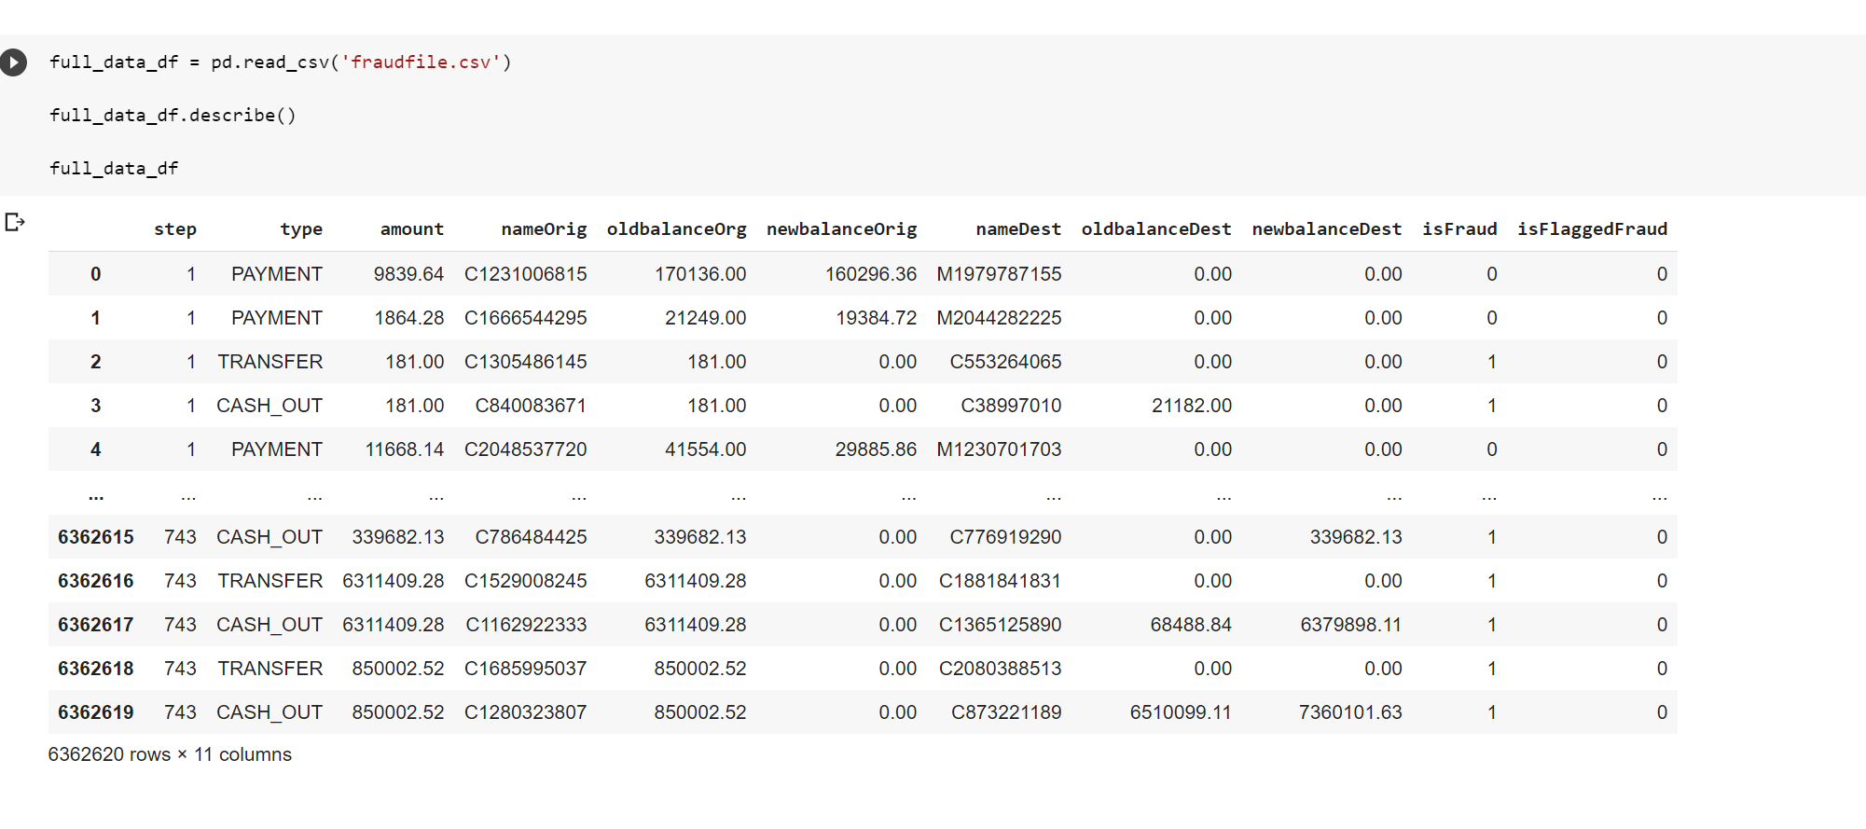
DATA
Our data set has over 6 million rows and 11 columns
We have a total fraud count of 8213
0.12% of the transactions in this data set are fraudulent

Slide 9
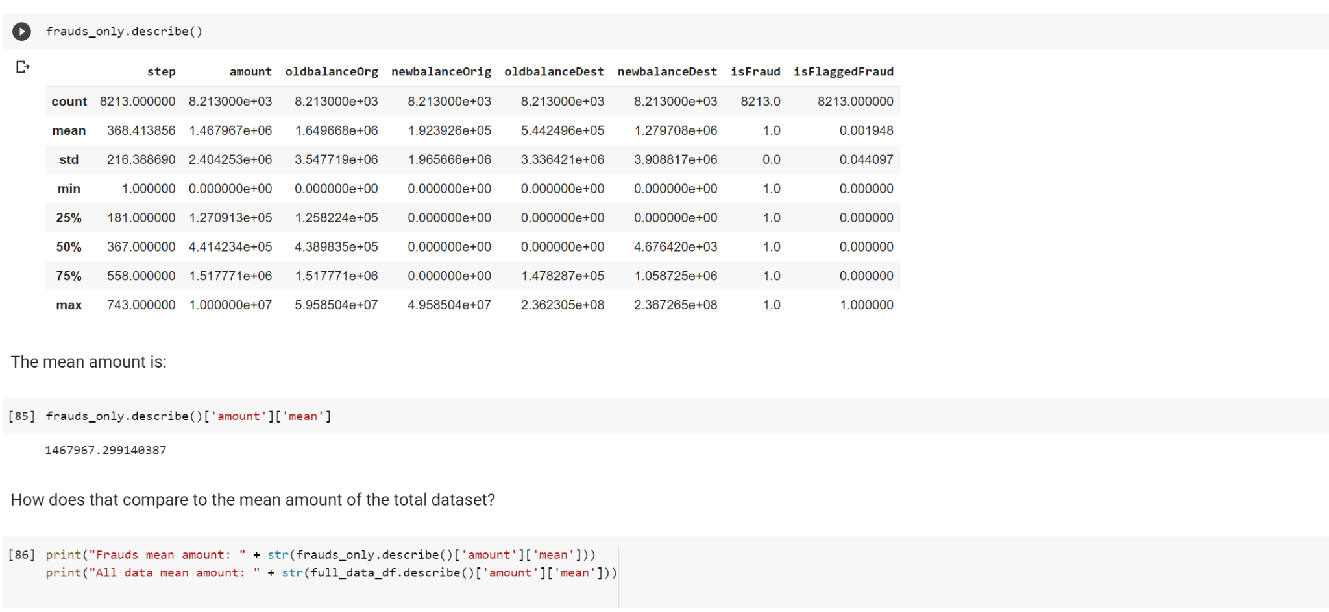
DATA EXPLORATION
Fraud transactions have 10X the mean amount of non-fraud transactions
Fraudulent accounts where transactions are originating have higher overall balances

Slide 10
DATA EXPLORATION
The current model of this financial institution has a flag rate of 0.2%
Most fraudulent transactions came from cash out and transfers
There are 5492 accounts with both fraudulent and legitimate transactions

Slide 11
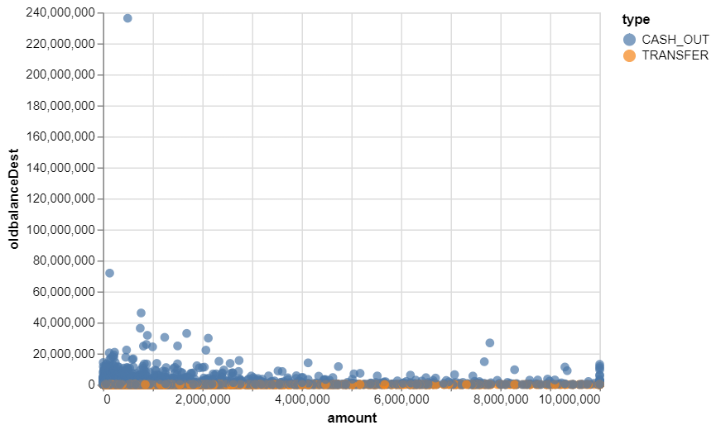
SIZE OF TRANSACTIONS
Transfer frauds seem to occur only where there the old balance of the destination account is low
Cashing out is the preferred method for large amounts

Slide 12
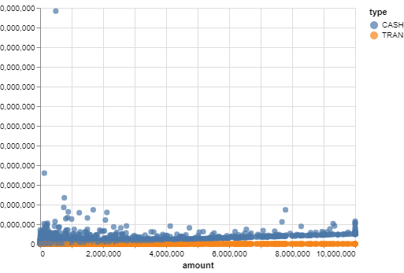
SIZE OF TRANSACTIONS
Cash out frauds drain the account balance of the originating account to 0
Transfers are generally used to move large sums of money and keep the existing account intact

Slide 13
Machine Learning Formulations
3

Slide 14
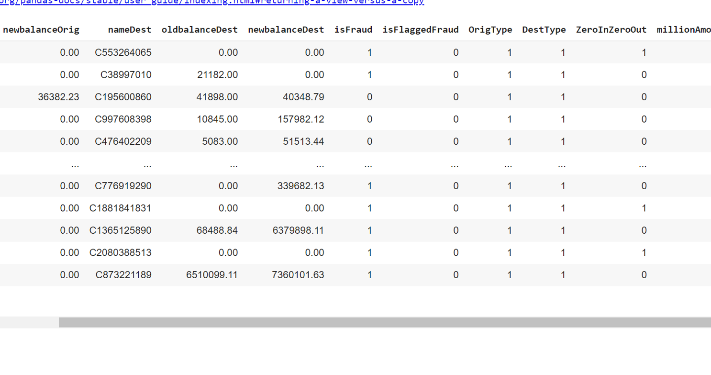
GENERATING FEATURES
Fraudulent Accounts that have a 0 account balance before and after
Accounts that frequently have million dollar transaction amounts
Account that have ten million frequently

Slide 15
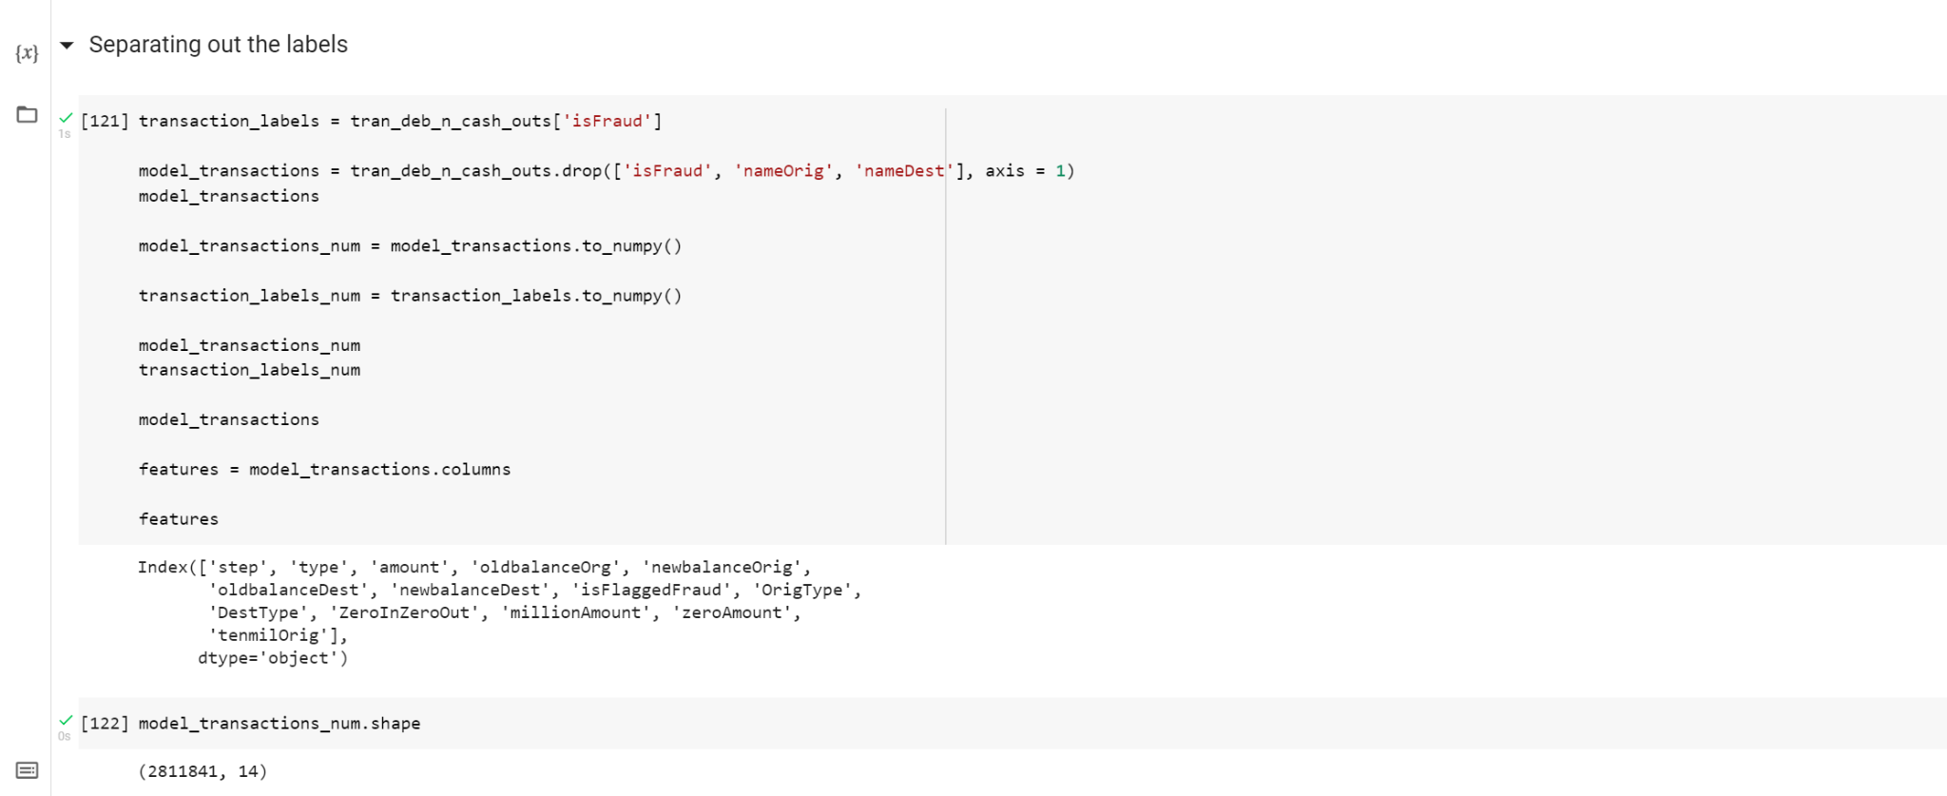
LABELS

Slide 16
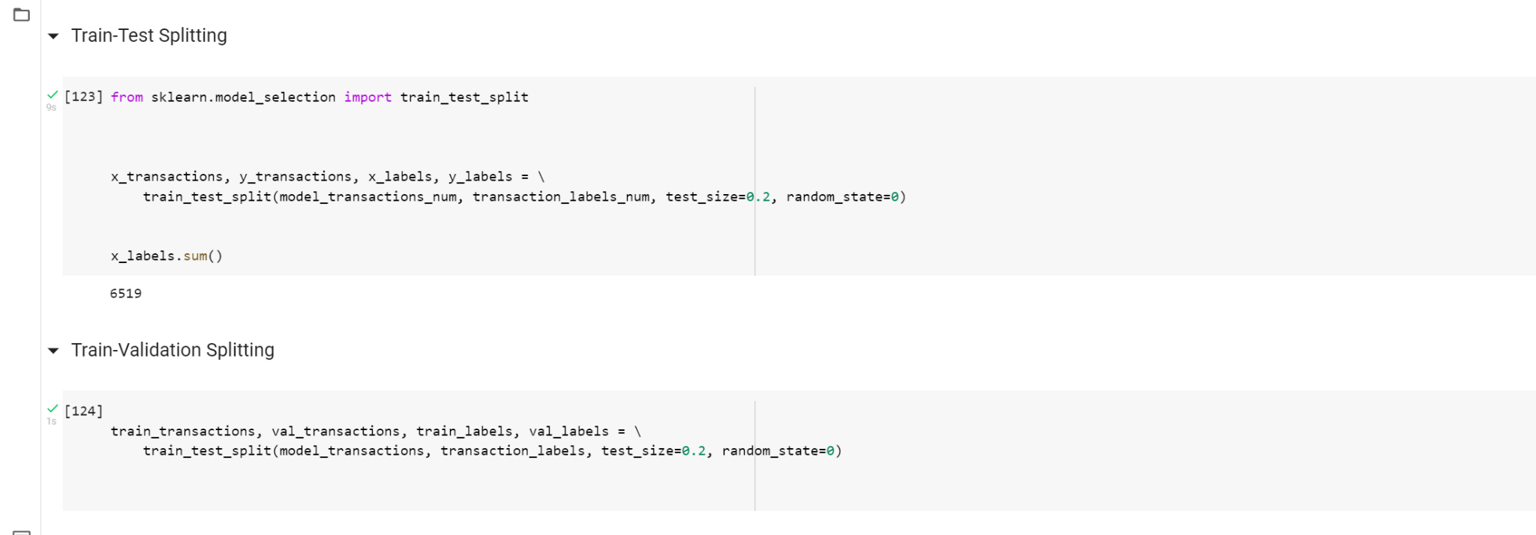
TRAIN, TEST AND VALIDATION
Our Testing Set is 20% of our model

Slide 17
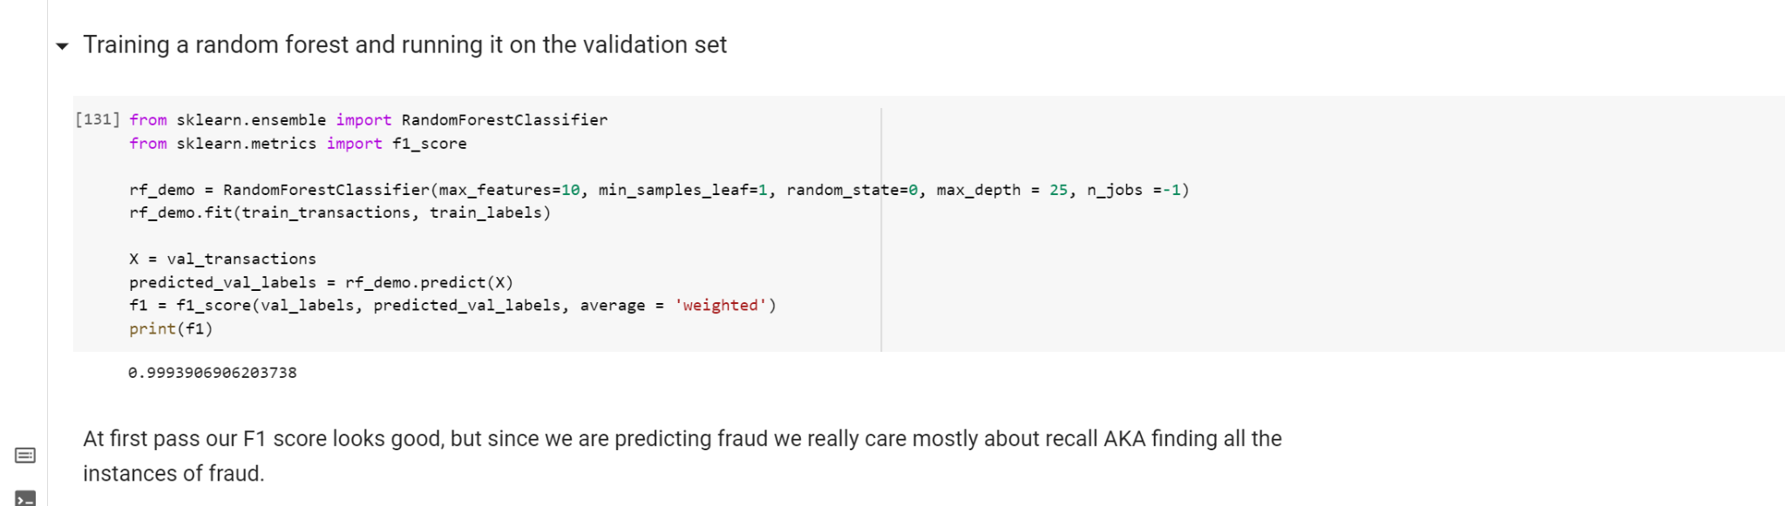
RANDOM FOREST
We used a random forest to train our data and ran it on a validation set
We also found our F1-score
However, we do not care about our F1 score. We are really interested in recall

Slide 18
RANDOM FOREST FEAT

Slide 19
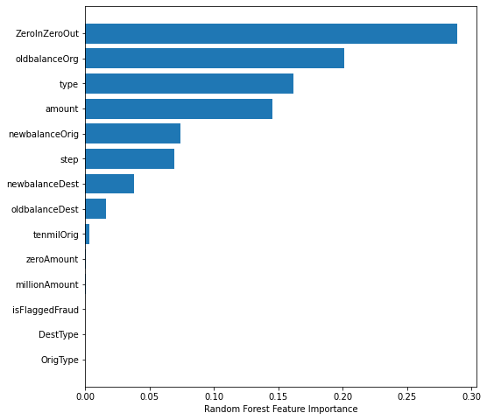
RANDOM FOREST FEATURE IMPORTANCE
We can see ZeroinZeroOut is the most important feature
Secondly, the oldbalance of the Origin account is also important

Slide 20
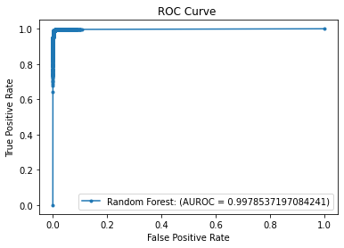
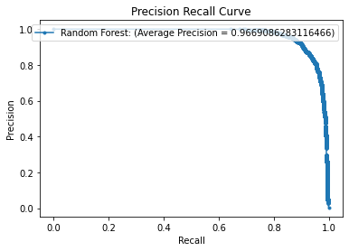
RANDOM FOREST FEATURE IMPORTANCE
The ROC curve shows we quickly rocket up to an 80% true positive rate but that last 20% is slow and in trying to indentify that last bit of true positives we also flag a number of false positives

Slide 21
Limitations
4

Slide 22
RANDOM FOREST FEATURE IMPORTANCE
The ROC curve shows we quickly rocket up to an 80% true positive rate but that last 20% is slow and in trying to identify that last bit of true positives we also flag a number of false positives

Slide 23
Conclusions
5

Slide 24
CONCLUSION
We were able to build a predictive model that flagged fraud better than the original model

